Slide 1
Wasserstein GAN
20170489 이재원, 20200130 김유준, 20200438 이다영

Slide 2
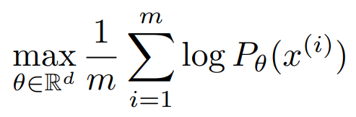
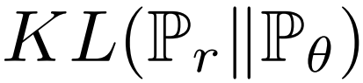
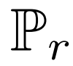
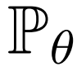
Introduction
Learning a probability distribution
Maximum likelihood estimation
Equivalent to ‘minimizing ’
( : distribution of real data, : distribution of parametrized density)
However, KL divergence is not always finite.
Notes:
P_r, P_theta -> KL 추가

Slide 3
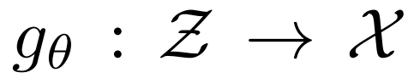
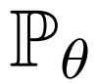
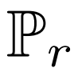
Generative Adversarial Networks (GANs)
Z : random variable with distribution p(z)
X : original data
Find parametric function
Distribution induced by function is
Measure how close the distribution and

Slide 4
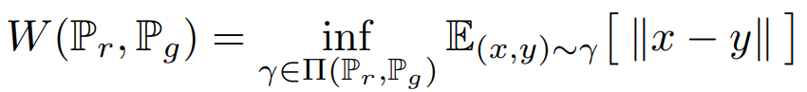
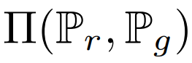
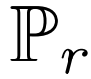
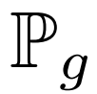
Distances
Total Variation (TV) distance, Kuller-Leibler (KL) divergence, Jensen-Shannon (JS) divergence and Earth-Mover (EM) distance
The Earth-Mover (EM) distance or Wasserstein-1
where is set of joint distributions whose marginals are and

Slide 5
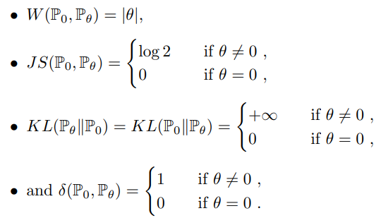
Example
Let , be distribution of and
JS, KL and TV not continuous

Slide 6
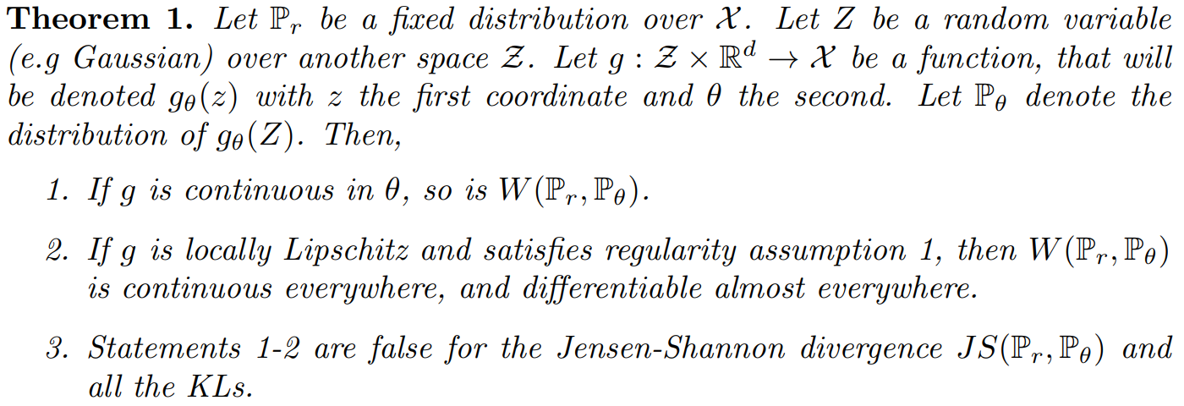
Theorem 1
Properties of EM distance

Slide 7
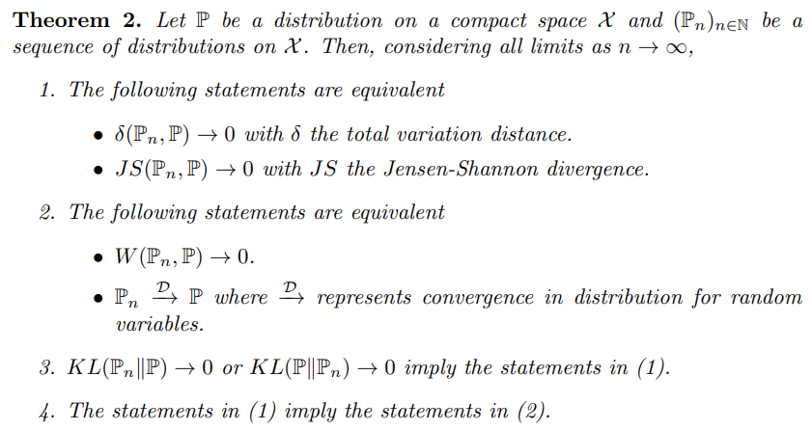
Theorem 2
Relative strength of the topologies induced by distance/divergence
(strongest) KL > JS, TV > EM (weakest)

Slide 8
Wasserstein GAN
Convergence in JS divergence implies convergence in Wasserstein distance
Distribution obtained by minimizing Wasserstein distance might have nicer properties
Sequence of distribution converging by
JS divergence
Sequence of distribution converging by Wasserstein Distance
Zero-one distance?

Slide 9
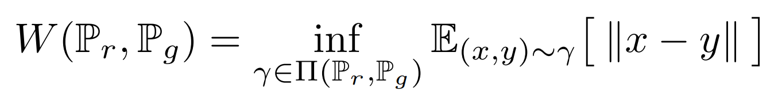
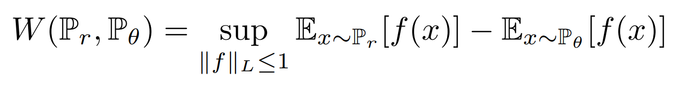
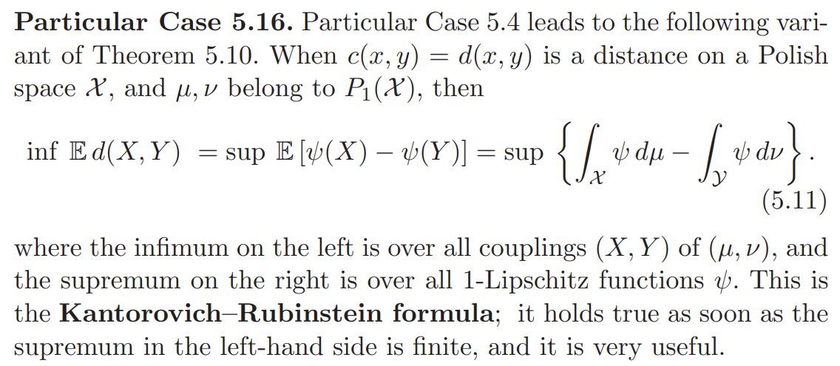
Kantorovich-Rubinstein Duality

Slide 10
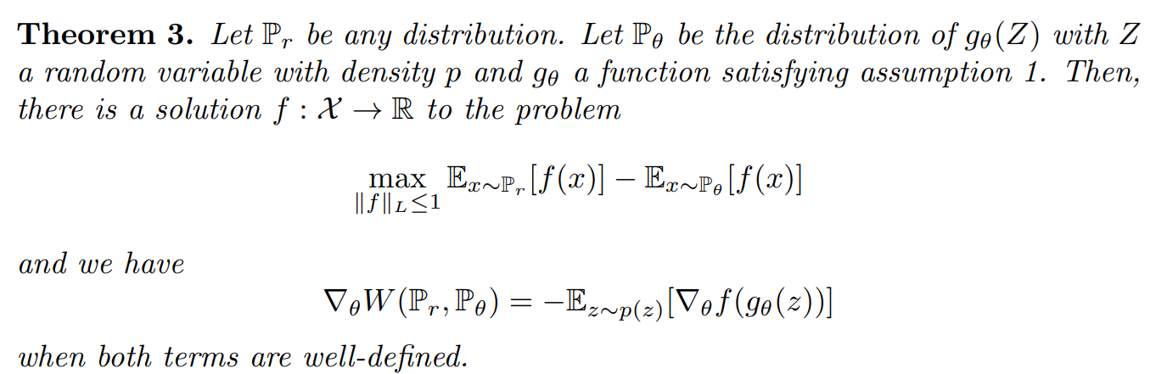
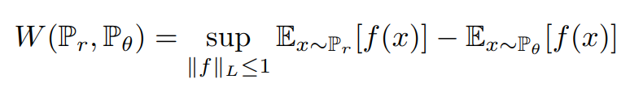
Theorem 3
Maximum is attained by a function f
We can calculate the gradient of Wasserstein distance using f
Recall

Slide 11
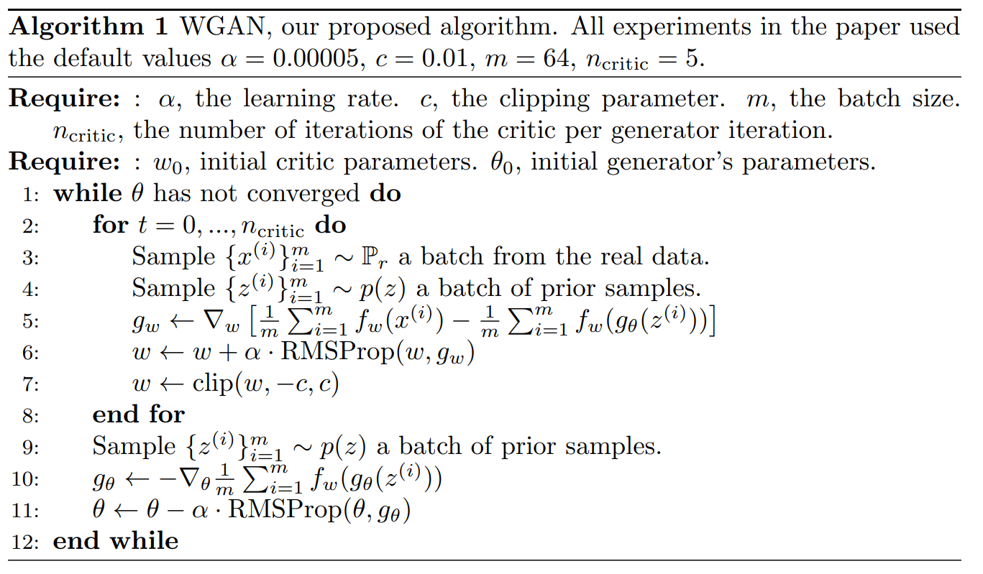
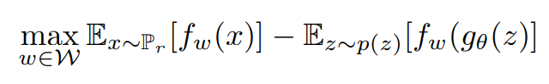
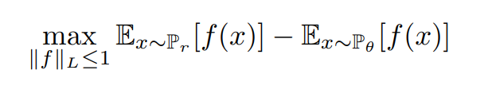
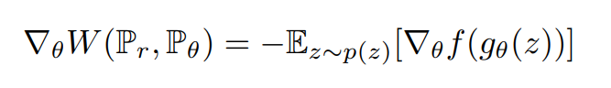
WGAN Train Algorithm
Theorem 3

Slide 12
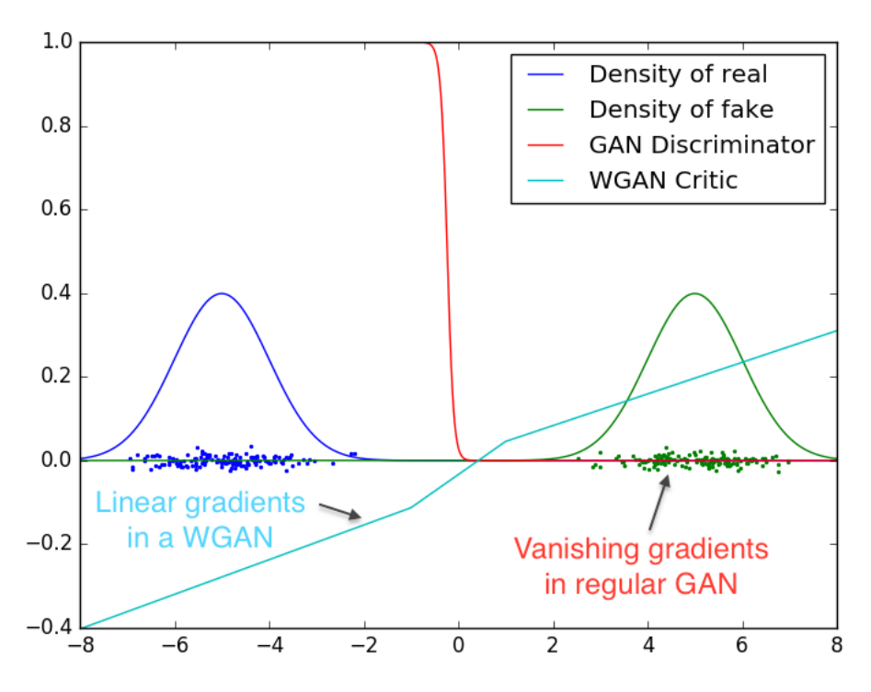
Critic: f_w

Slide 13
Empirical Results

Slide 14
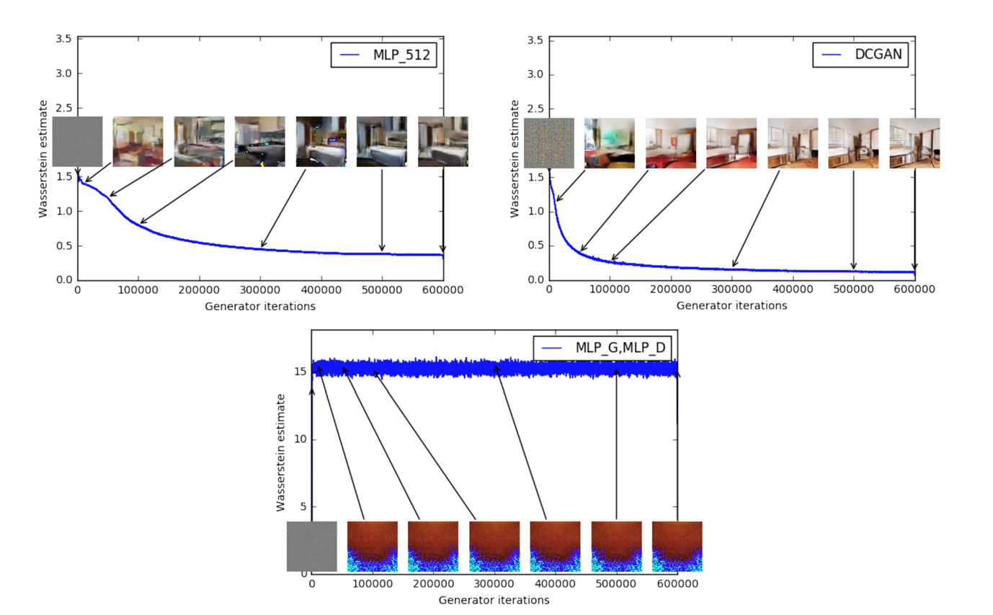
Experimental Procedure

Slide 15
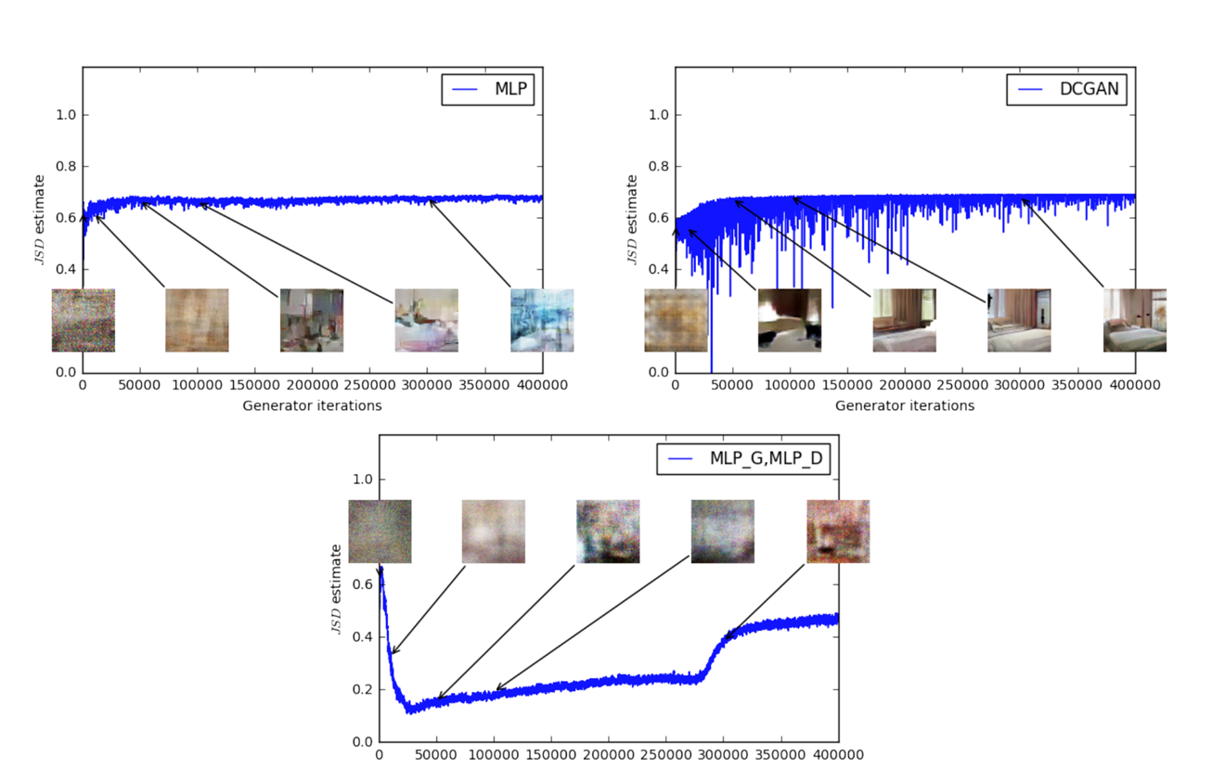
Meaningful Loss Metric

Slide 16
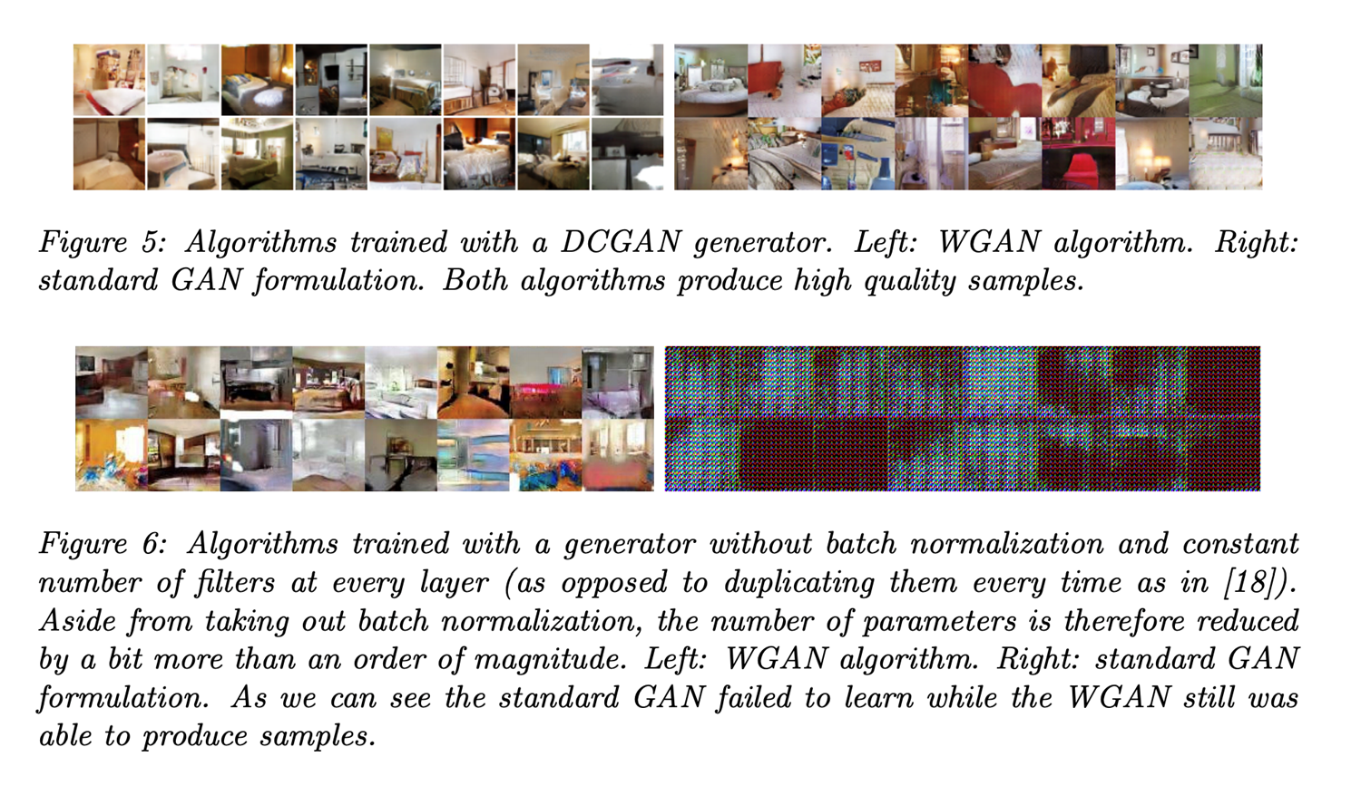
Improved Stability

Slide 17
Experiments

Slide 18

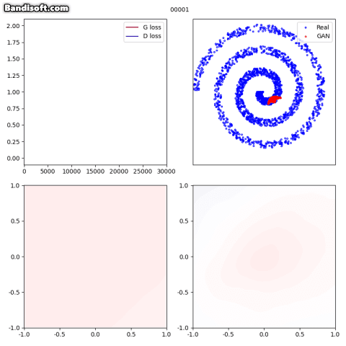
Synthetic Generation

Slide 19
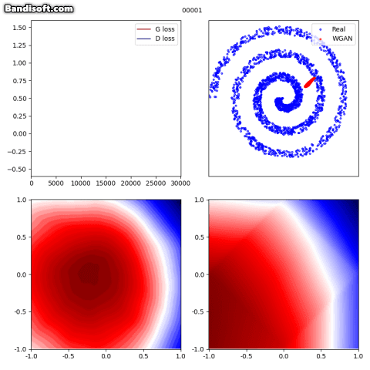
Synthetic Generation

Slide 20
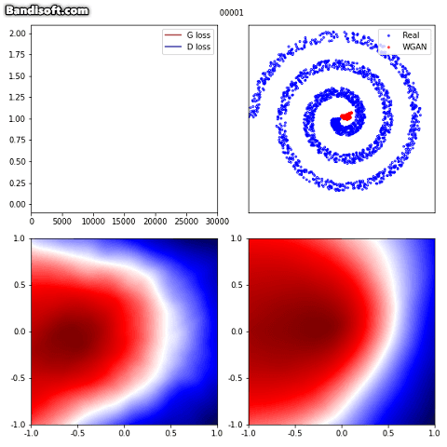
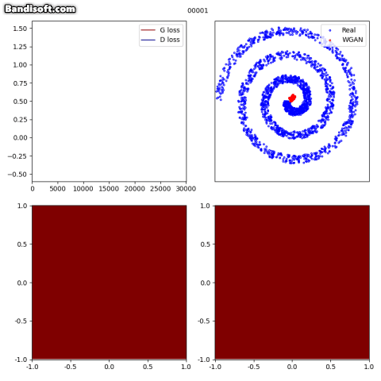
Synthetic Generation
• Weight clipping = 0.1
• Weight clipping = 0.001

Slide 21
Conclusion
WGAN은 discriminator의 학습을 EM distance (Wasserstein distance)를 사용하여 변형
기존 GAN의 경우 Generator와 Discriminator의 학습 균형이 중요함
WGAN의 경우 critic(Discriminator)을 최대한으로 최적 상태까지 학습시킨 후 generator를 학습
결과적으로 GAN 학습을 안정화 시키고 mode collapse 문제를 해결
https://colab.research.google.com/drive/1beqRuSMevSESIDJWKmfjSXZgAsg01mOl?usp=sharing
Notes:
P_r, P_theta -> KL 추가

Slide 22
Thank You !

Slide 23

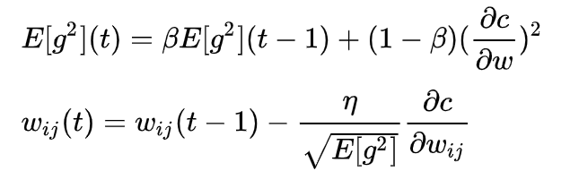
Extra Materials - RMSProp
RMSProp

